Slide 1

Birmingham ODN Hepatitis Data
A Walkthrough of Our Custom Local Database

Slide 2
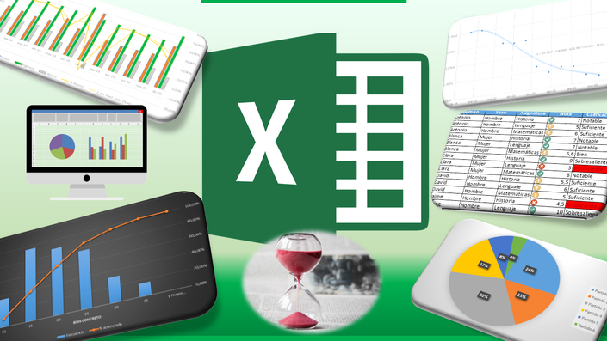
How Data Is Currently Stored
ED, Referral, PCR, and historical datasets (Transplant, Dual Therapy, Clinical Trials) are maintained in separate spreadsheets
Arden and GEM capture and manage data nationally
This Photo by Unknown Author is licensed under CC BY-NC-ND

Slide 3
Do We Have Clear Visibility of Our Data?
Do we know how many patients have been cared for, including historical treatments?
Can we easily identify a patient’s latest treatment and outcome (at least within our dataset)?
Do we know whether any patients have been referred but not yet treated?
Are patient outcomes being properly followed up?
Are there patients who may need to be revisited?
Do we have sufficient data to support workload planning and resource utilisation?
  Multiple referrals
  Retreatment
  Resupply
How easily can we produce high-level figures and insights for meetings and decision-making?

Slide 4
What We Have Done
Developed an instant dashboard to capture and visualise data from existing spreadsheets
Made it easier to produce figures for meetings and reporting, with minimal additional work from source data
Introduced a new system (ED Testing) to record the data we need in a more standardised format. Enabled more comprehensive and consistent analysis

Slide 5
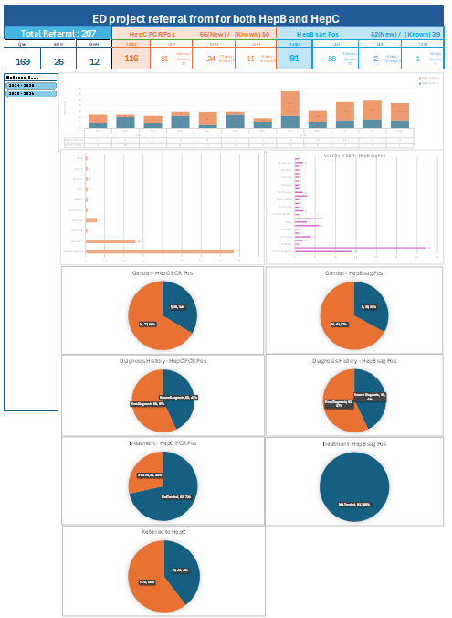
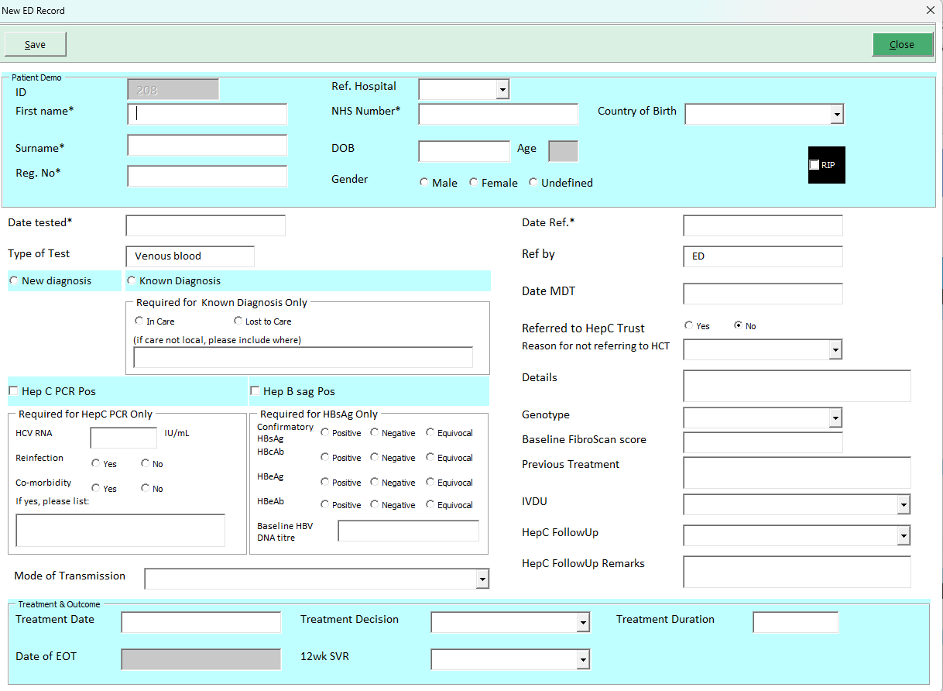
EDTest project

Slide 6
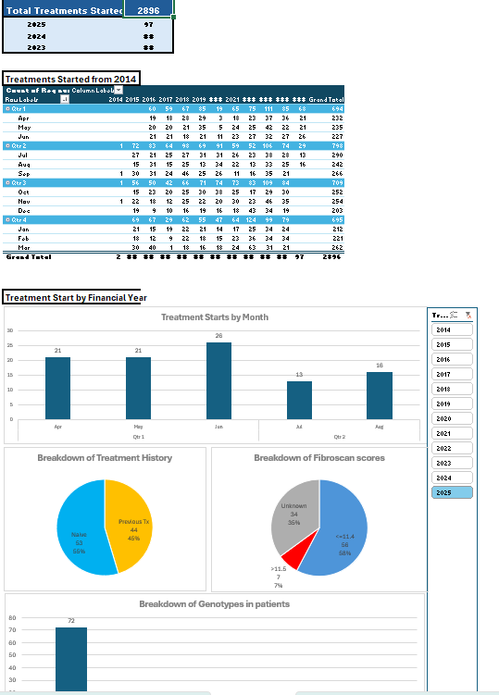
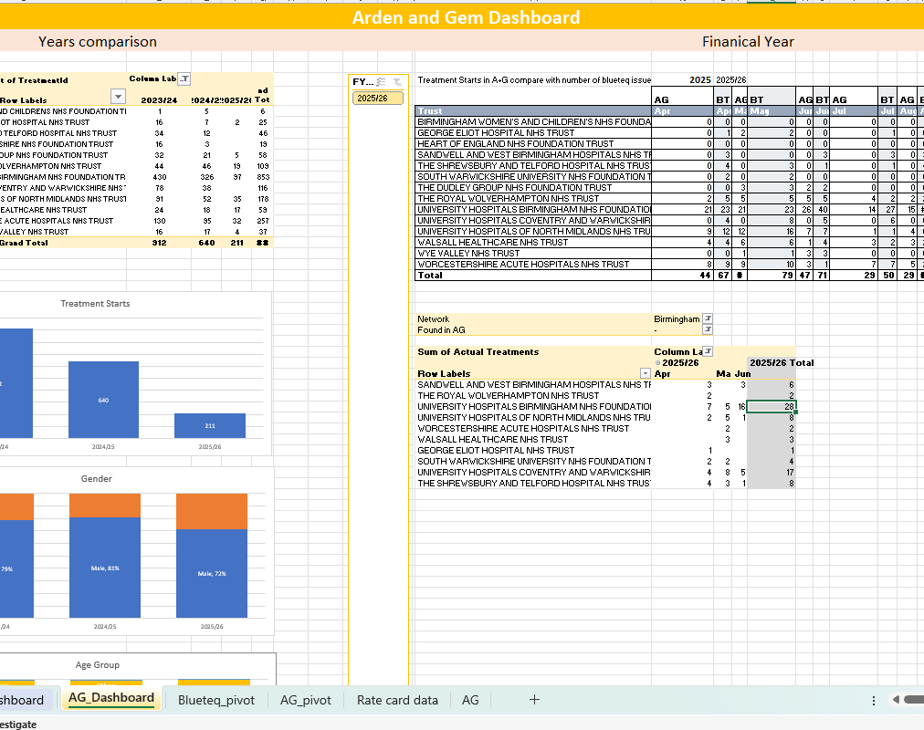
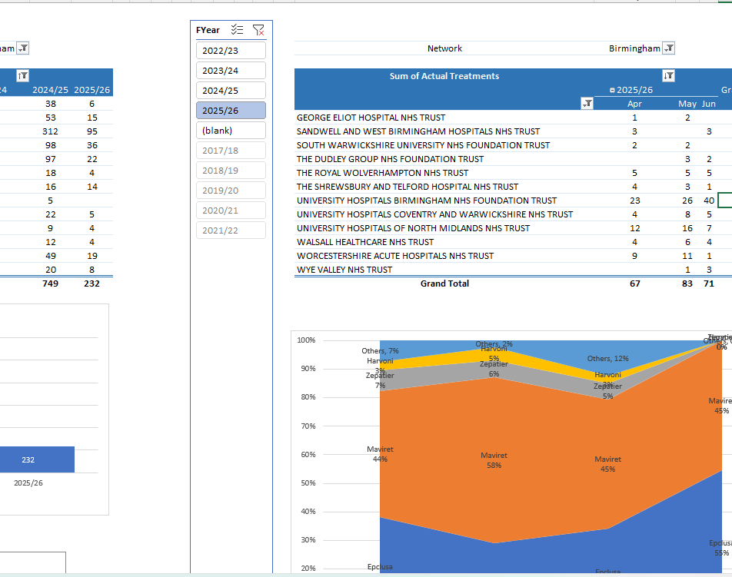
Centralized dashboard
Dashboards are built on different sources while keep existing input mechanism unchanged
Consolidated those data from corporate e.g. Arden and Gem and Blueteq
Group together all the data view a more centralized views in our dashboards.
Can achieve data comparison and cross checking

Slide 7

What’s Next?
A tailored local database for the department
Centralized storage of all relevant data under one roof
Improved accessibility, consistency, and analysis

Slide 8
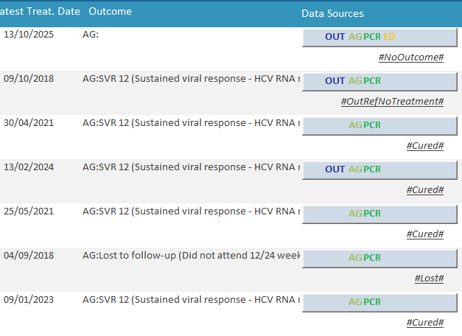
Patient Panel
A centralized panel to view all records for a patient.
Patient Search Bar: Search patients by Name, Date of Birth (DOB), Hospital Number, or NHS Number.
Displays latest treatment date and treatment outcome (based on your own data).
Shows source of data: Outreach referrals, ED, PCR, Arden, and Gem.
Includes Patient Tag indicating current status: Cured, Lost, Under Treatment (no outcome yet), or Lost.

Slide 9
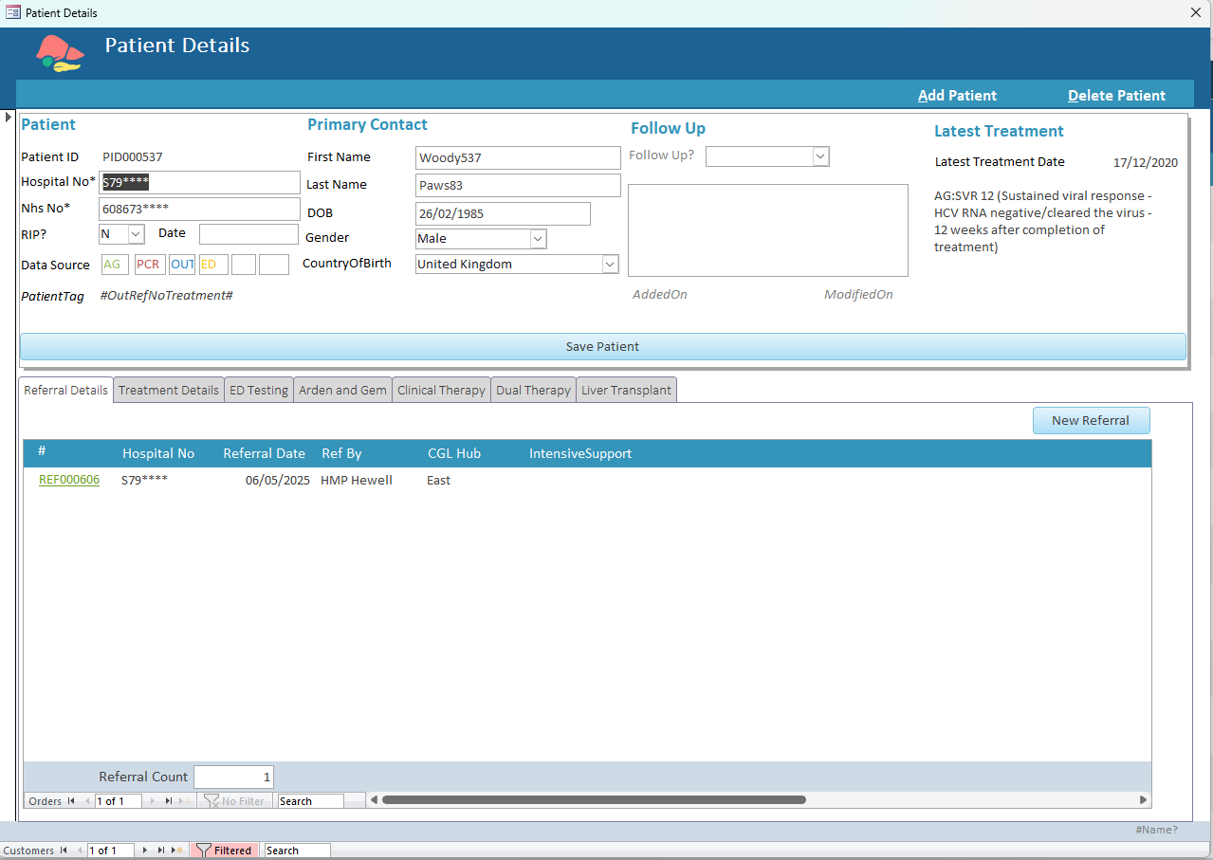
Patient Details
Access: Double-click any patient to open their full record. This form consolidates all key information for the individual in one place.
Demographics: NHS Number, Date of Birth (DOB), and Hospital Number are clearly displayed and editable.
Shared patient demographics across our system reduce duplicate entry errors and make maintenance easier.
Tabbed Views: Quickly switch between different data types, such as Referral Details, Treatment Details, and ED Referrals, all within a single window.
Provides a one-stop view for efficient patient checks.
Patient Tags : Displays the patient’s latest status, automatically generated by the system based on the most recent treatment record.
Data Sources: Clearly indicates the origin of the data for each record.

Slide 10
Patient Details – Background Color Highlight
Patient demographic backgrounds are color-coded for easier identification.
Special color highlights patients who have sadly passed away or require follow-up, making alerts and actions more visible.

Slide 11
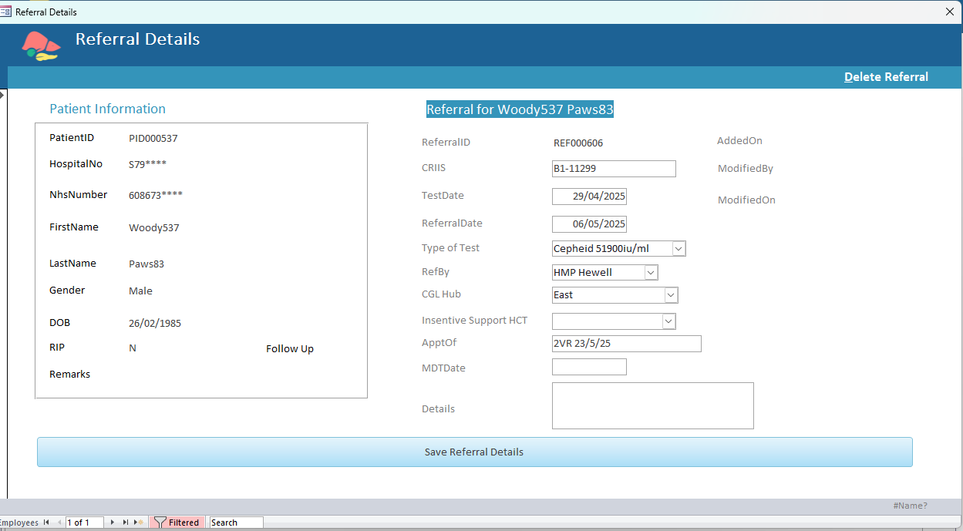
Outreach Referrals
Integrates existing outreach spreadsheets into the system
Key fields: Referral Date and Source of Referral, enabling analysis such as yearly referral counts and referral origins.
Improves tracking of patients who were referred but not treated (details and reporting explained in a later slide).

Slide 12
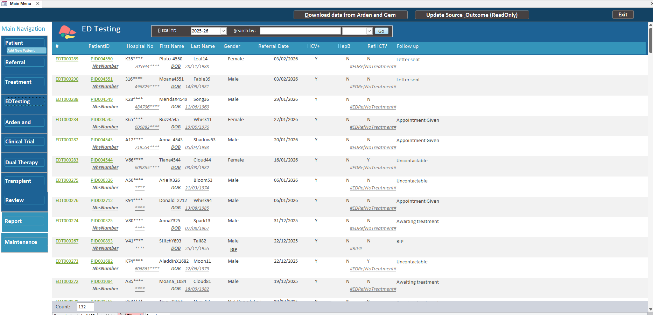
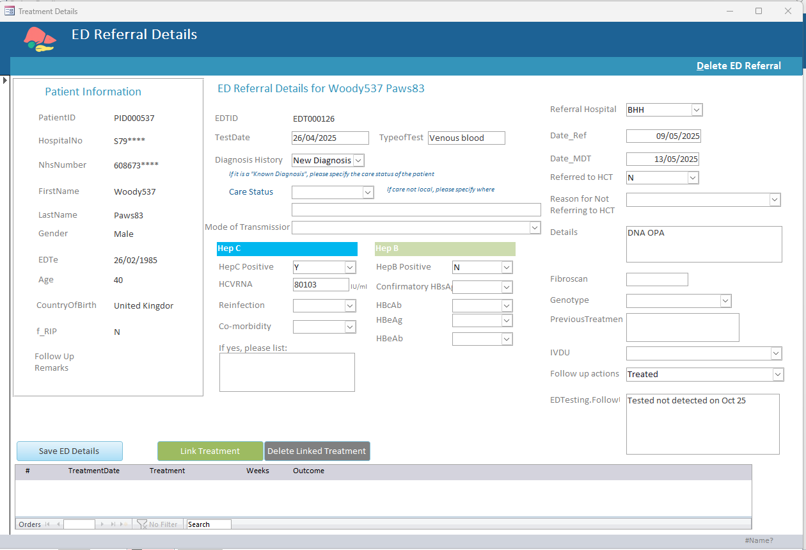
ED Referral
Migrates existing ED testing functionality into the system, eliminating the need to switch between platforms.
Provides a single, unified view of the patient.
Includes a linking function to connect existing treatments, reducing duplicate data entry.

Slide 13
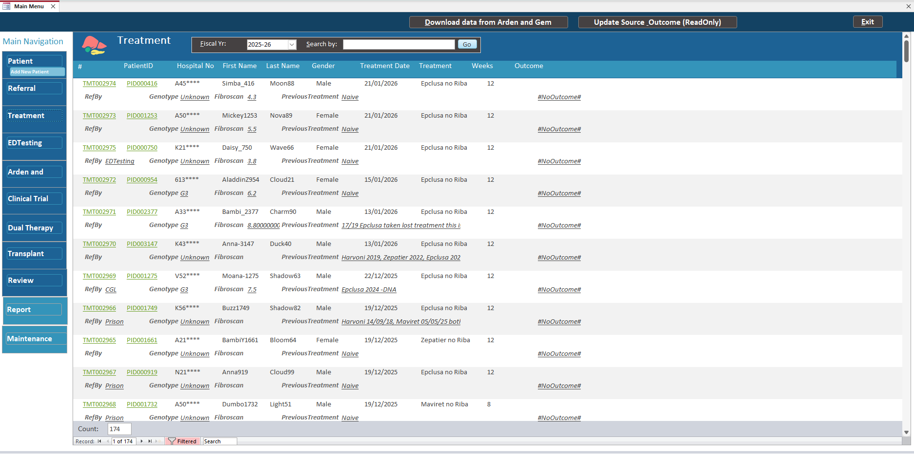
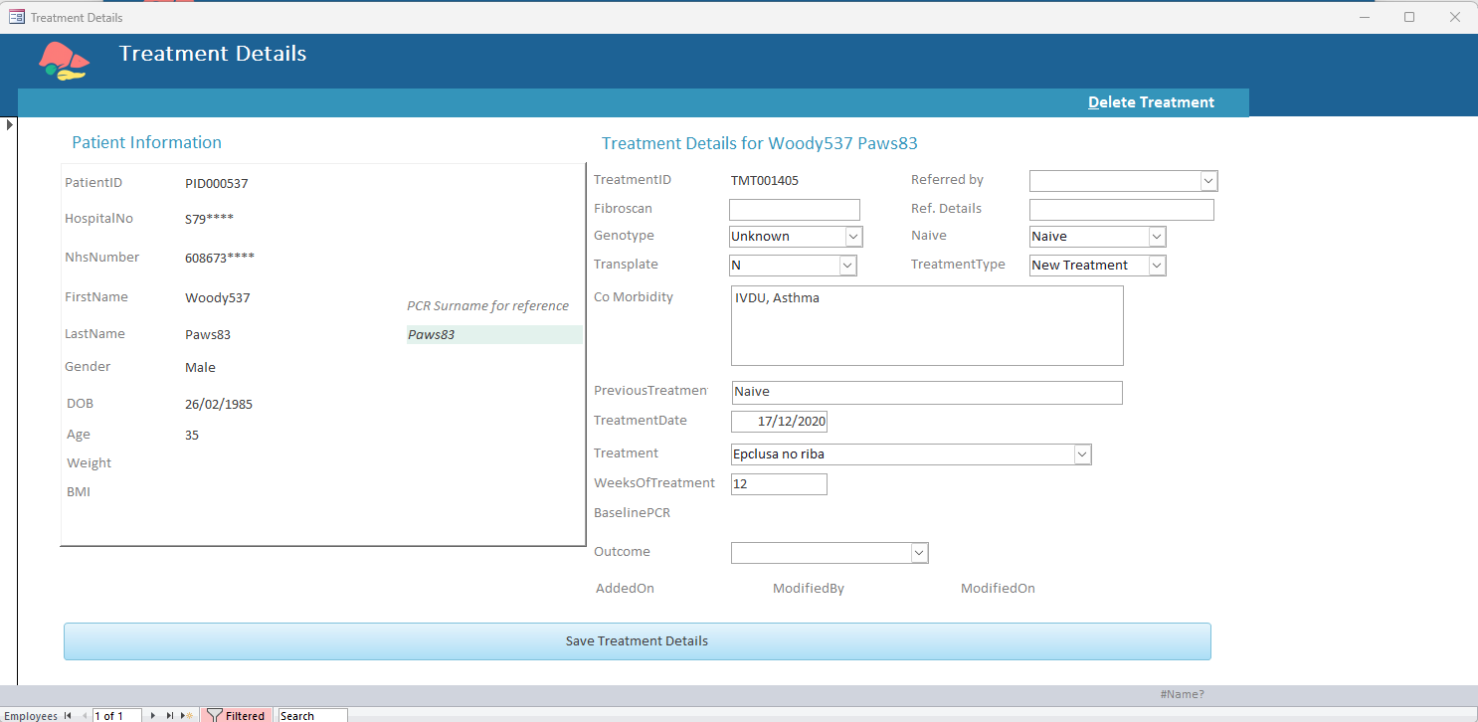
Treatment records
Migration of existing PCR spreadsheet
Maintains a local set of patient treatment records.
Allows local remarks to be added for each patient’s treatment.

Slide 14

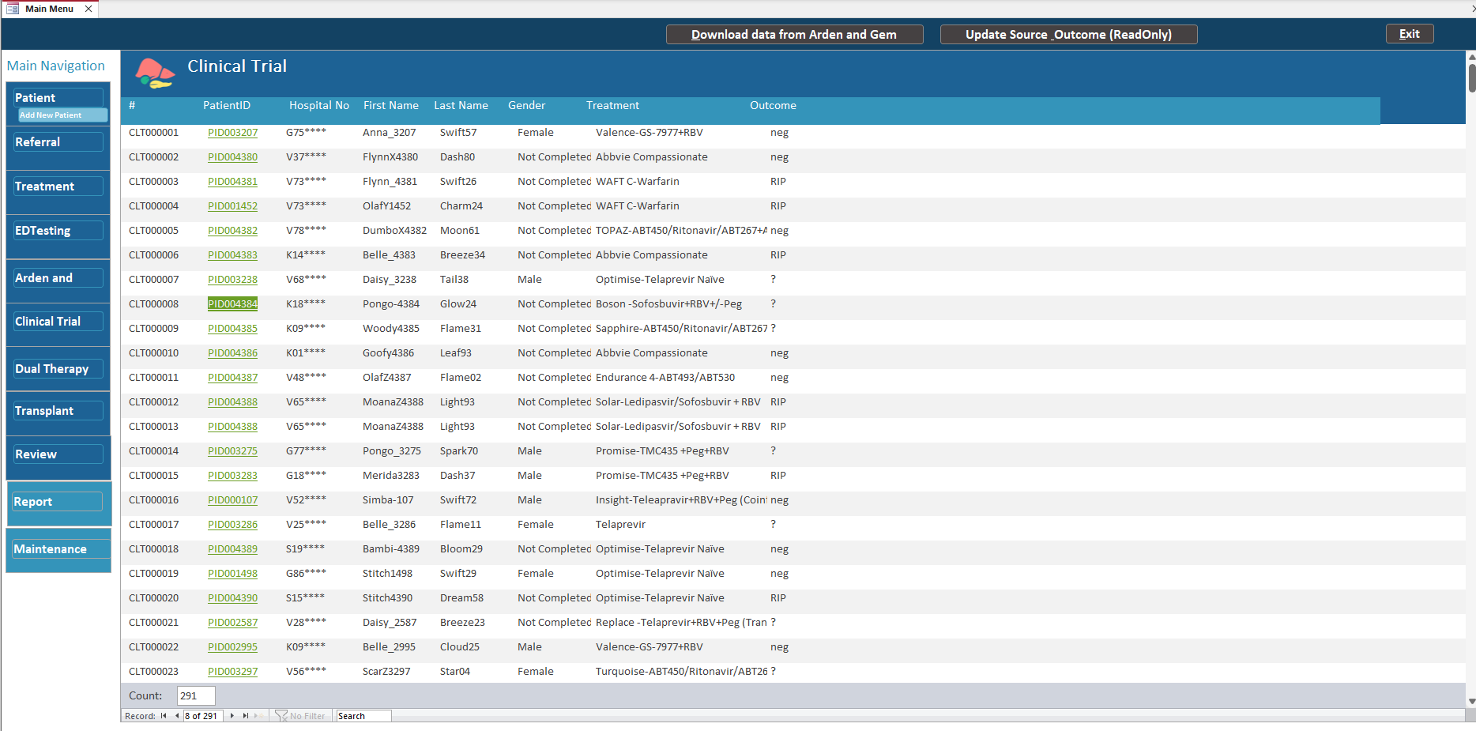

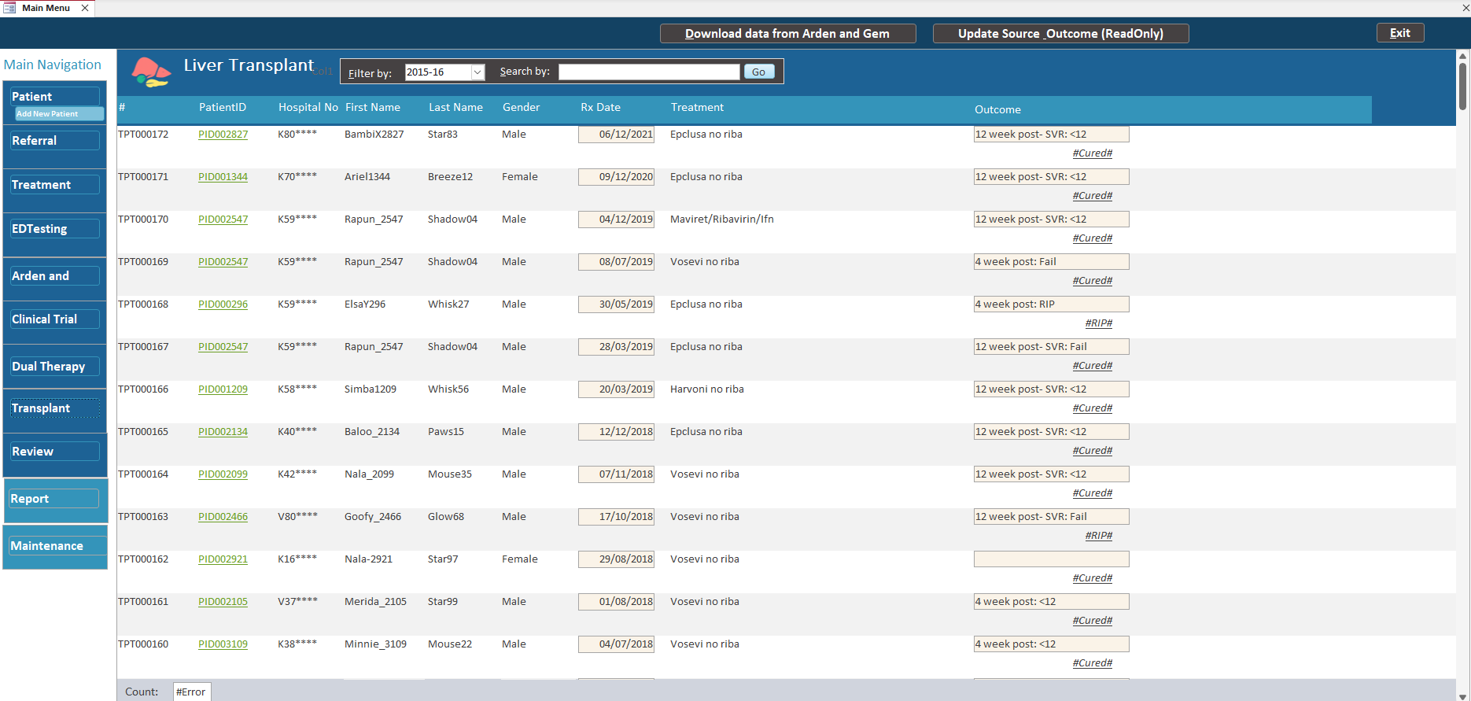
Historical data
Integrates historical records, such as Clinical Trials, Dual Therapy, and Transplant patients, which may not exist in Arden or Gem.
Consolidates all data into the local database for a unified view of the patient.

Slide 15
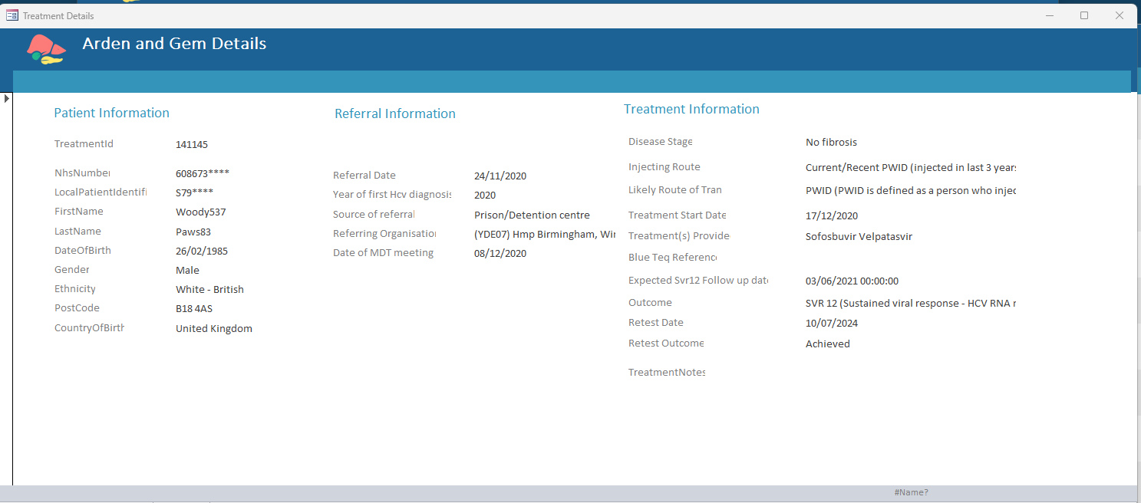
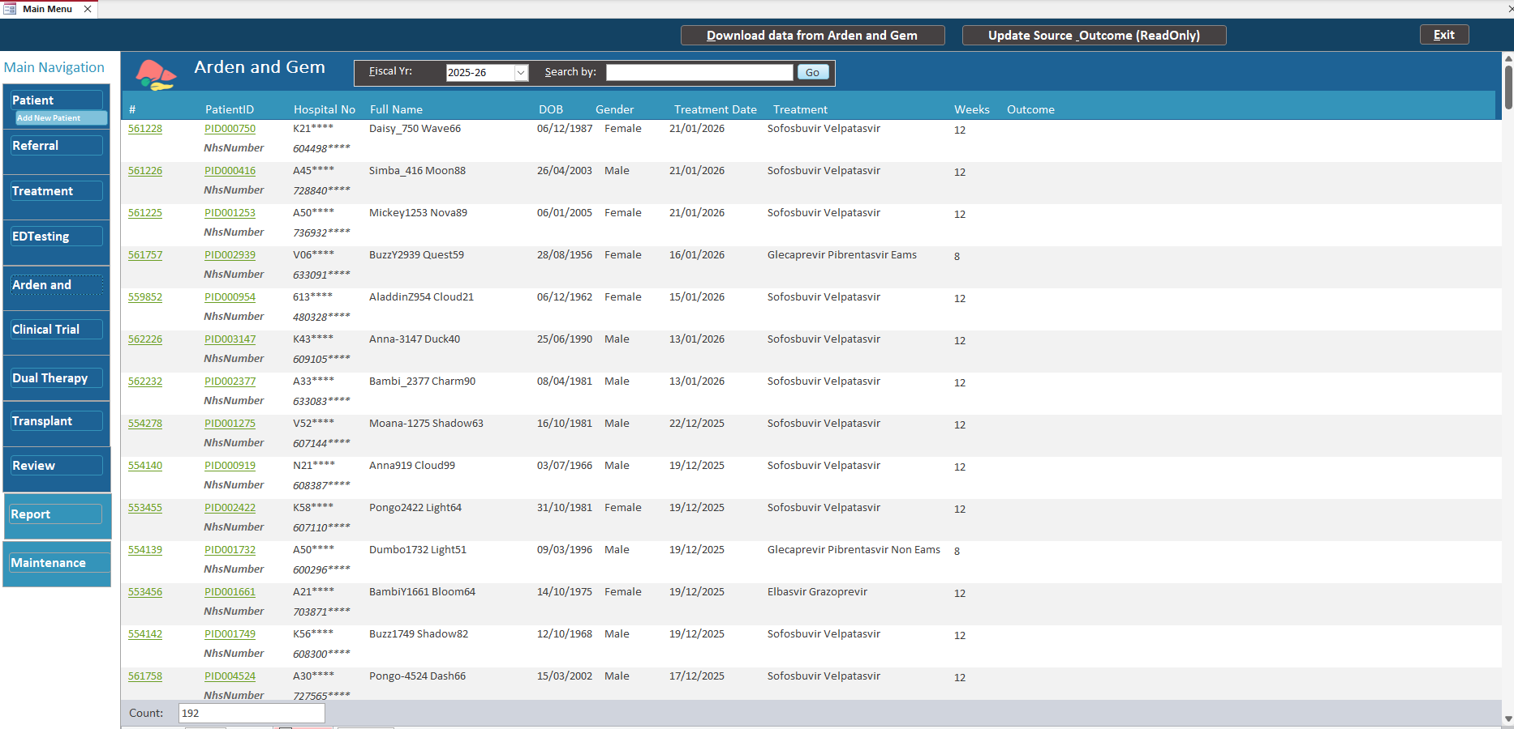

Arden and Gem
Enhances integration with nationalized data from Arden and Gem.
Allows download of exported treatment data from Arden and Gem for a unified patient view within the system.

Slide 16
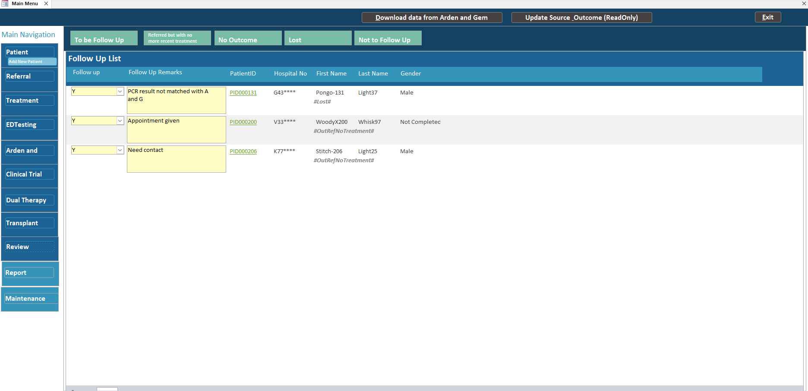
Patient Follow up
Provides a single-page overview of patients flagged for follow-up based on their Patient Tag.
Patients marked for follow-up are highlighted in the Patient Panel and flagged in the patient list for easy tracking.

Slide 17
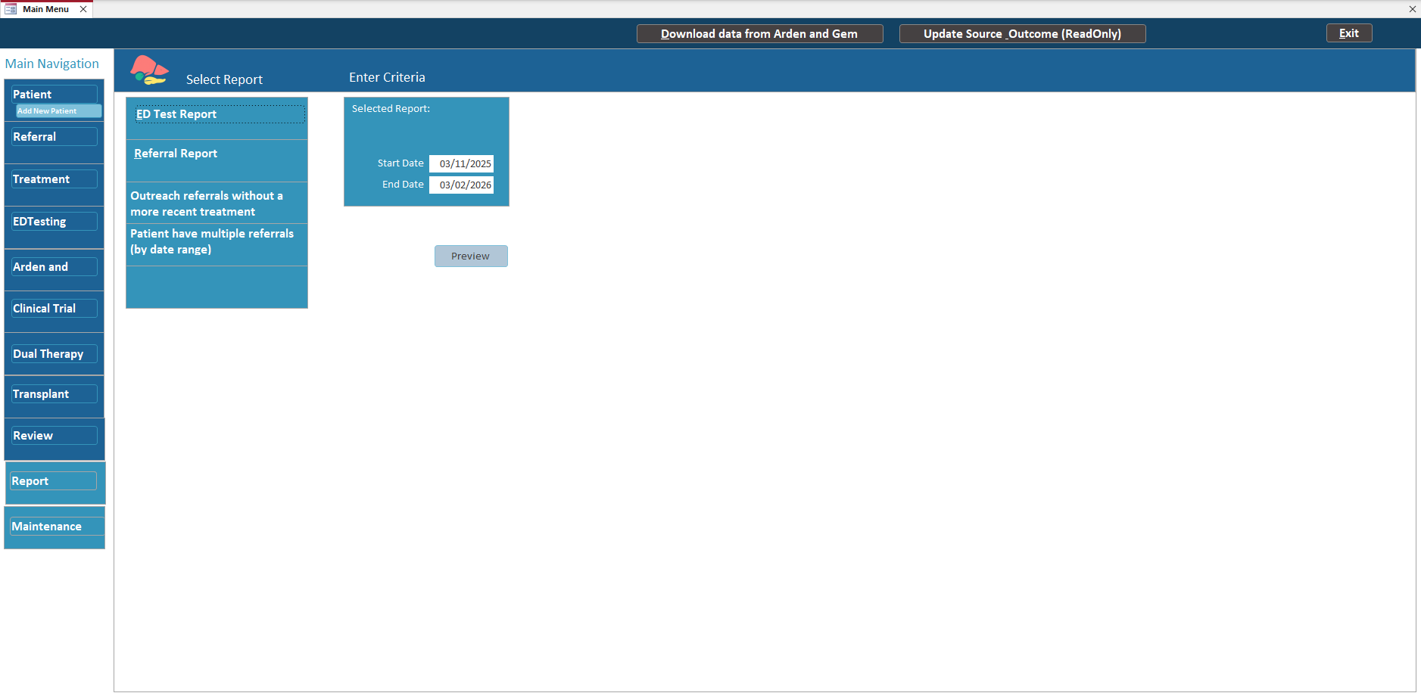
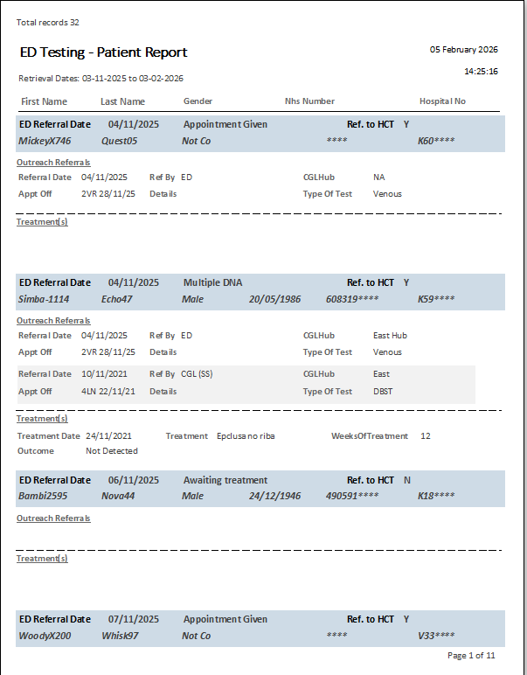
Reports
Provides customized reports tailored to our needs.
Offers an easy, at-a-glance view of selected data.
Reports can be printed or exported as PDFs, allowing review without needing system access.

Slide 18
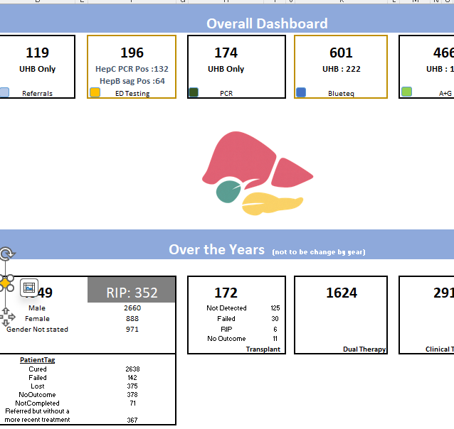
Centralized Dashboards
Provides dashboards in Excel format, ensuring access even when the system is unavailable (e.g., during meetings or WFH).
Displays high-level figures to support meetings, discussions, and decision-making.

Slide 19
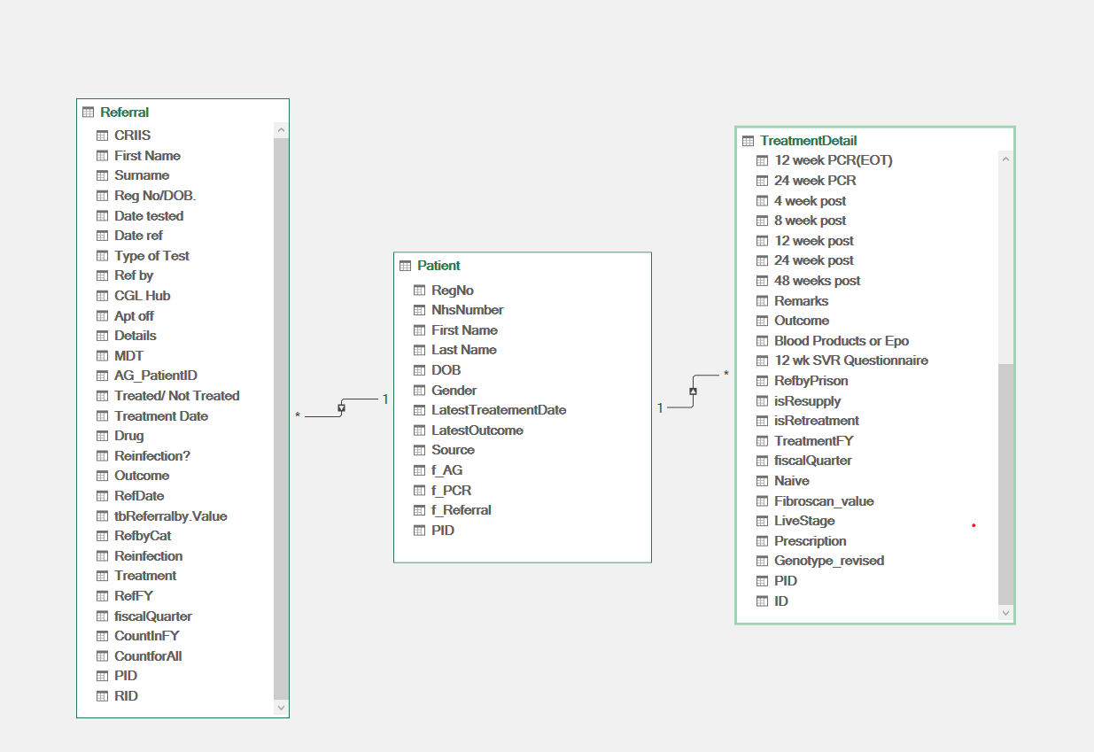
Proposed Data Structures
Patient
Referral
Treatment

Slide 20
Database – existing
Type | Pros | Con
Spreadsheet Databases | Primary usage. Used for daily workflow Contain most update information | Manual input → not standardized data → need data cleaning before analysis Contains data for UHB only
Arden and Gem | Information System with structured data Contains data for the whole ODN | Secondary repository. Used for data record only as the system have limited feature for daily workflow Not contain referral related data
Referral Database (Outreach spreadsheet)
PCR Database (EAP spreadsheet)
Arden and Gem System

Slide 21
Existing issues
Arden and Gem contains structured treatment data for the whole ODN, but it is not suitable for the daily operation uses
Referral data which are valuable is not recorded in Arden and Gem
Local spreadsheets are created to facilitate daily workflow
Unstructured data in local spreadsheets due to manual free-text input
Local spreadsheets with no connection to other trusts
Double entry (local spreadsheet and Arden and Gem)
No connection to other dataset including the treatment outcome which may be updated by other trusts

Slide 22
Why need a departmental database?
Data Quality & Storage Challenges
Requirement
Daily Operation Needs
Tools
MSAccess
Fragmented Storage
Spreadsheets stored across emails and multiple SharePoint folders
Multiple versions of the same files
Duplicate or Inconsistent Entries
Repeated patient details with discrepancies
Non-Standardized Data Input
Inconsistent formats (e.g. NHS number vs. registration number)
Some records contain insufficient or missing data
Easy data maintenance by nurses/admin staff
Listing view or printable format to support daily workflows
Reminder/alert system for missed processes or treatments
Search functionality
Patient-based and listing views (e.g. by financial year)
Management Requirements
Dashboard with high-level figures for meetings and decision-making
Insights and forecasting based on data trends
Development Considerations
Simple development process (suitable for a sole developer)
Tools to support data cleansing
Flexible setup with no additional installation required for end users

